Slide 1
alz.org | 800.272.3900

Slide 2
What is Dementia?
Dementia is not a diagnosis in and of itself. It describes a group of symptoms.
Dementia is the loss of cognitive or intellectual functioning such as thinking, remembering, or reasoning, that is so severe that it interferes with a person’s daily functioning and everyday life.
There are treatable or reversible causes of dementia; don’t assume that it is Alzheimer’s disease if you or someone you know is experiencing memory issues!

Slide 4
Alzheimer’s Disease
Alzheimer’s disease…
Is a progressive and fatal brain disease
Is the most common form of dementia
Is more prevalent than you think
Will bankrupt Medicare if left unchecked
Currently has no cure

Slide 5
What Are the Warning Signs?
EARLY DETECTION MATTERS
Talk to a doctor if you notice these signs in yourself or someone you care about
Memory changes that disrupt daily life
Challenges in planning or solving problems
Difficulty completing familiar tasks
Confusion with time or place
Trouble understanding visual images and spatial relationships
New problems with words in speaking or writing
Misplacing things and losing the ability to retract steps
Decreased or poor judgment
Withdrawal from work or social activities
Changes in mood or personality
Notes:
Since we have a captive audience and we want to educate at every opportunity, I’ve added this slide as a teaser for our KTTS programs. Both instances, we’ve been invited back to do an expanded program open!
Eliminate this slide at your discretion!!

Slide 6
Alzheimer’s Disease: More than Just Memory Loss
MEMORY
ORGANIZATION
LANGUAGE
ATTENTION
DEMENTIA
REASONING
ABSTRACTION
JUDGEMENT
PERCEPTION

Slide 7
What Happens to the Brain?

Slide 8
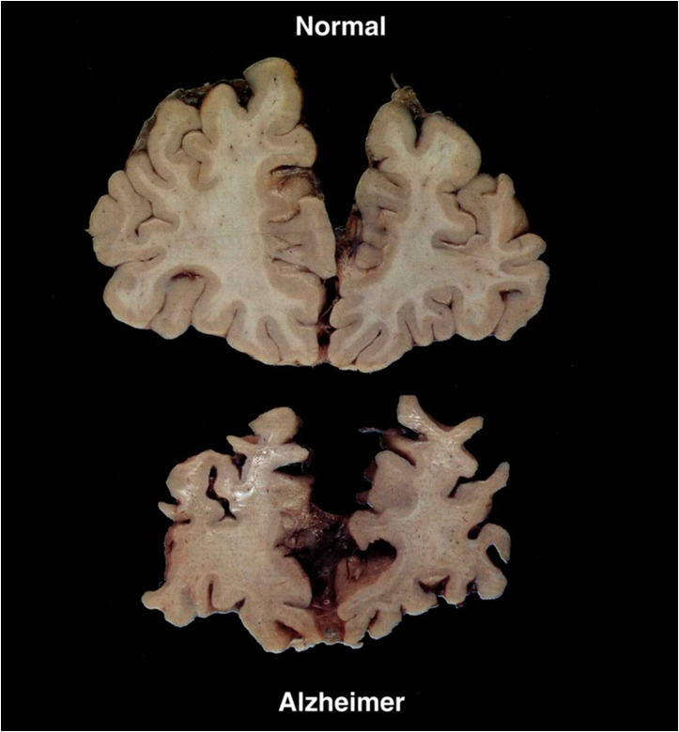
Image appears courtesy of Dr. Richard E. Powers, Director of the Alabama Bureau of Geriatric Psychiatry

Slide 9
Steps to a Good Diagnosis
Medical and social history
Mental status evaluation
Physical exam
Neurological exam
Brain Imaging
Lab work
Importance of early diagnosis

Slide 10
Communication Strategies
Don’t argue or correct
Ask for what you want, not what you don’t want
You may need to show them what you want (as dementia progresses, cues will become more visual and tactile than verbal)
Respond to their emotion
Validate (don’t try to orientate)
Cooperate with misperceptions
Don’t be afraid of therapeutic lying, compassionate deception or fiblets!! Literal truth often unkind!
Address the distress and always supply what’s being lost to the disease!

Slide 11
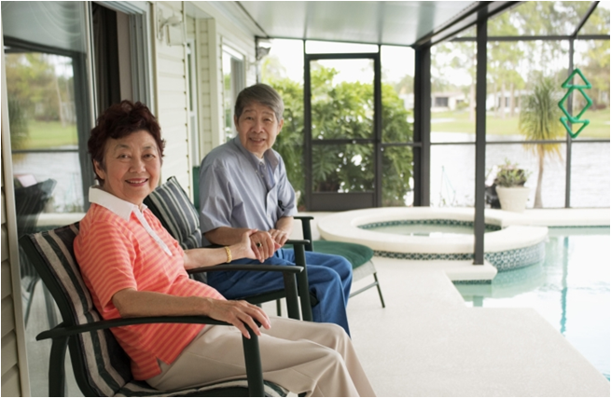
Care Options Families Will Need with a Dementia Diagnosis
Respite
Home health
Residential
Palliative
Support Groups

Slide 12
Who is the Alzheimer’s Association?
World’s leading voluntary health organization in Alzheimer’s care, support and research
Founded in 1980 by a group of family caregivers
National office in Chicago
Public policy office in Washington, D.C.
Over 70 local chapters

Slide 14
Michigan Great Lakes Chapter
Headquarters in Ann Arbor
Regional offices in Kalamazoo, Lansing and Muskegon
Service area includes 23 counties
Serve an estimated 50,000 individuals with Alzheimer's disease

Slide 15
Regional Offices
Ann Arbor | South Central Region
Branch, Hillsdale, Lenawee, Livingston, Monroe, Washtenaw Counties
Lansing | Capital Area Region
Barry, Calhoun, Clinton, Eaton, Ingham, Jackson Counties
Kalamazoo | South West Region
Allegan, Berrien, Cass, Kalamazoo, Saint Joseph, Van Buren Counties
Muskegon | West Shore Region
Lake, Mason, Muskegon, Newaygo, Oceana Counties

Slide 16
Statistics
An estimated 5.7 million Americans have Alzheimer’s disease; more than 150,00 in Michigan
by 2050…14 million is projected
Increasing age is the greatest risk factor for Alzheimer’s disease:
By age 65, 1 of every 8 persons has Alzheimer’s
By age 85, 1 of every 3 persons has Alzheimer’s
A person with Alzheimer’s will live an average of 8 years and up to as many as 20 years from the onset of symptoms
Every 65 seconds, someone in America develops Alzheimer’s disease (by 2050…every 33 seconds)
40% of a person’s years with Alzheimer’s are spent in the most severe stage of the disease

Slide 17
Statistics…Continued
16.1 million American family members and friends provided care for a person with Alzheimer’s disease or other dementia
These caregivers provided 18.4 billion hours of unpaid care valued at $232 billion in 2017
10,000-12,000 people turn 65 every day
More than 50% of Alzheimer’s disease/dementia caregivers rate the emotional stress of care giving as high or very high
1/3 of dementia caregivers report symptoms of depression
20% sacrificed their own medical care
AD is the only cause of death among the top 10 in America without a way to prevent, cure or even slow progression

Slide 18
What do we offer?
Increasing Concern and Awareness
24/7 Helpline: 800.272.3900
Website: alz.org
eNews
Enhancing Care and Support
Information and Referral
Education
Support Groups
Care Consultations
Safety Programs
Online Caregiver Tools

Slide 19
What do we offer?
Accelerating Research
Alzheimer’s Association International Conference
TrialMatch
Advancing Public Policy
Advocates
Growing Revenue
Walk to End Alzheimer’s
The Longest Day June 2018
RivALZ
Third Party Fundraising

Slide 20
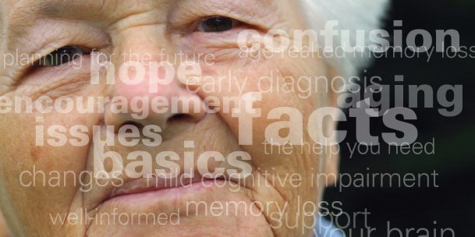
Education
Persons diagnosed with Alzheimer’s
Living with Alzheimer’s: For People with Alzheimer’s
Community programs
Know the Ten Signs: Early Detection Matters
The Basics: Memory Loss, Dementia and Alzheimer’s Disease
Understanding Alzheimer’s
eLearning
Alz.org/education

Slide 21
Education
Family caregivers and volunteers
Living with Alzheimer’s: For Caregivers
Legal and Financial Planning
Building Caregiver Skills
Driving and Dementia
Late Stage programs
Annual Research Nights
Long term care staff
Foundations of Dementia Care
Web-based: essentiALZ
CARES: A Dementia Caregiving Approach
Request specific programs

Slide 22
Online Caregiver Tools
Alzheimer’s and Dementia Caregiver Center – alz.org/care
ALZConnected
Connect with caregivers through our online social community
Alzheimer’s Navigator
Helps Families Navigate Alzheimer's
Helps guide you to answers by creating customized action plans and providing access to information, support and local resources

Slide 23
Research
Alzheimer’s Association International Conference every July
TrialMatch

Slide 24
Nation’s largest event to raise awareness and funds for Alzheimer’s care, support and research.
Held annually in more than 600 communities nationwide, this inspiring event calls on participants of all ages and abilities to reclaim the future for millions.
Register for a walk near you… alz.org/walk
Allegan County | Ann Arbor | Brighton | Chelsea Area
Jackson | Kalamazoo (Portage) | Lansing | Lenawee County Ludington | Monroe County | Muskegon | St. Joseph |
Calhoun County (Marshall)

Slide 25
2016 Kalamazoo Walk
69 teams  600 walkers  Raised over $65,500
2018 A2Y Walk ~ Sunday, October 7
Washtenaw Community College
Register today! Start a Team! Join a Team!
alz.org/walk 800.272.3900

Slide 26
Other Fundraising Events
Rockin’ for Rehab – Friday, May 11
RivALZ – Saturday, May 19
The Longest Day – Thursday, June 21st (And all year!)
David E. Rutledge Charity Golf Outing – Monday, July 9^{t}
^{Contact} lmichalski@alz.org for more info

Slide 27
alz.org | 800.272.3900

